Slide 1
WARM UP

Slide 2
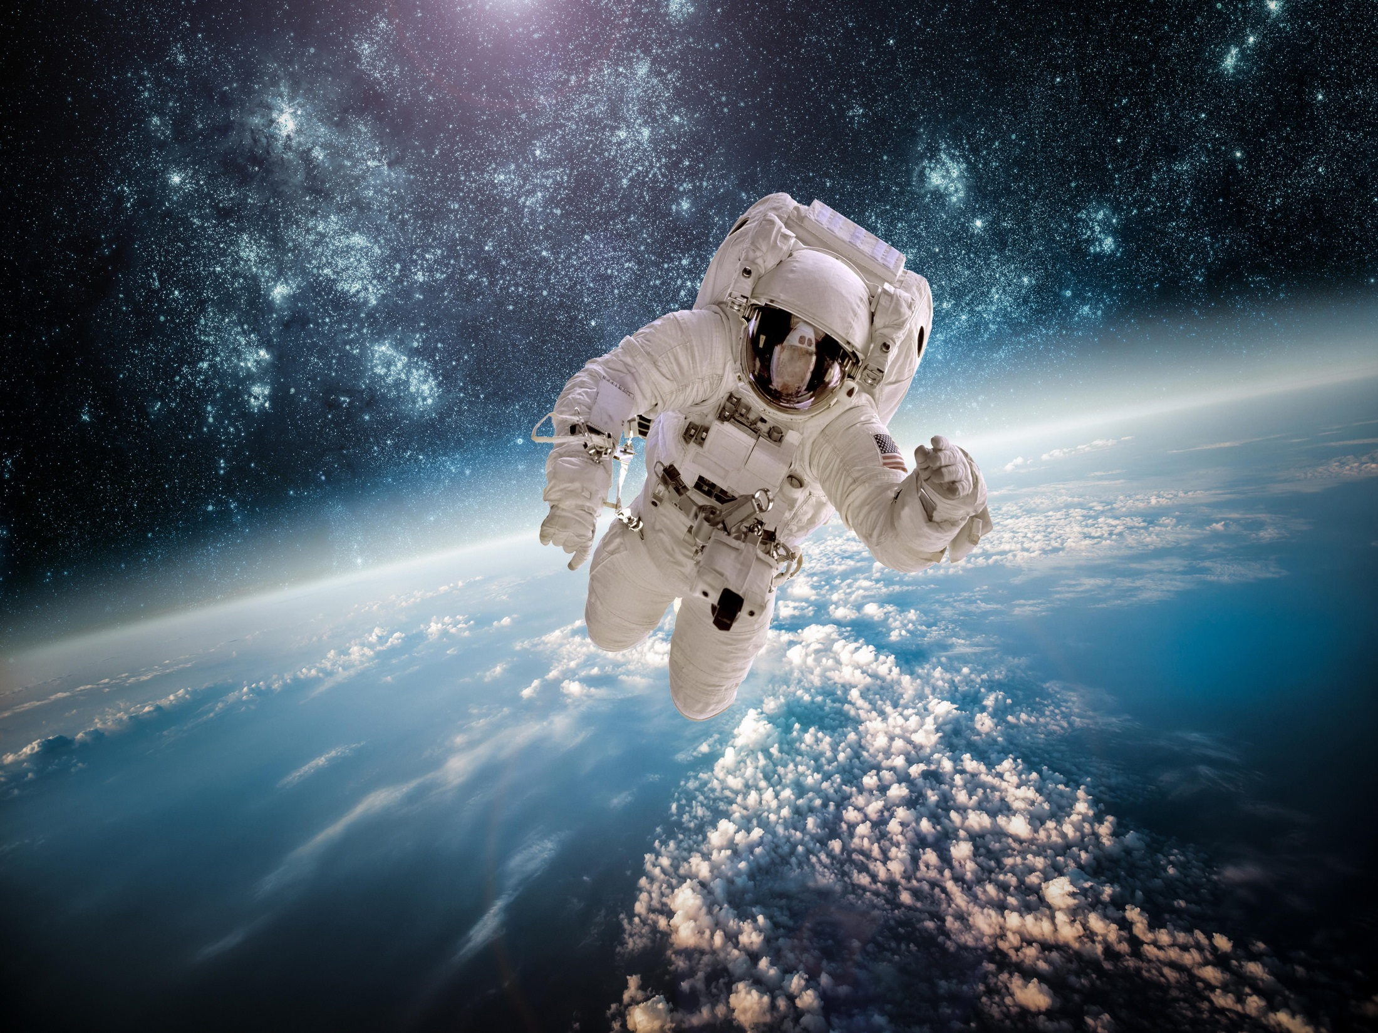
1
2
KEY WORD:
5 letters
3
4

Slide 3
space
astronaut
2020

Slide 4
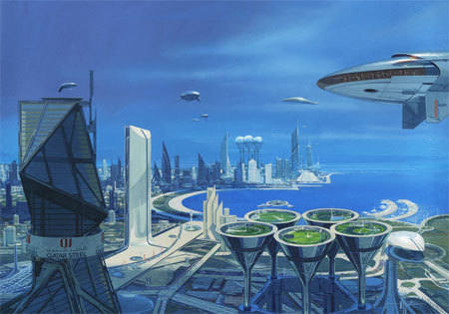
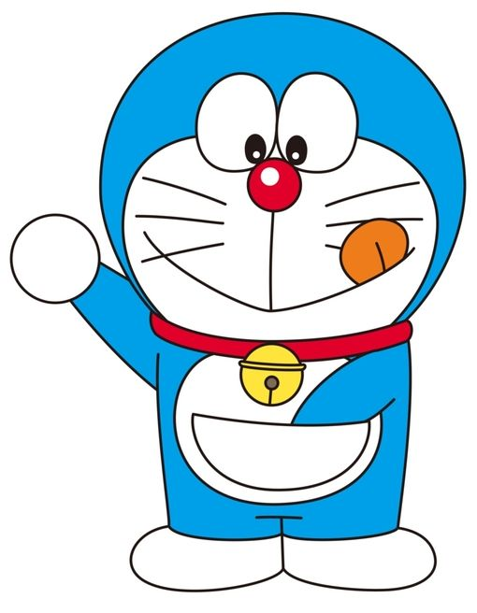
UNIT 8 : LIFE IN THE FUTURE
PART B : Speaking
2100

Slide 5
QUESTION 1:
A (n)_____________ is someone who always believes that good things will happen.
optimist

Slide 6
QUESTION 2:
A (n)____________is a person who thinks that bad things are more likely to happen.
pessimist

Slide 7
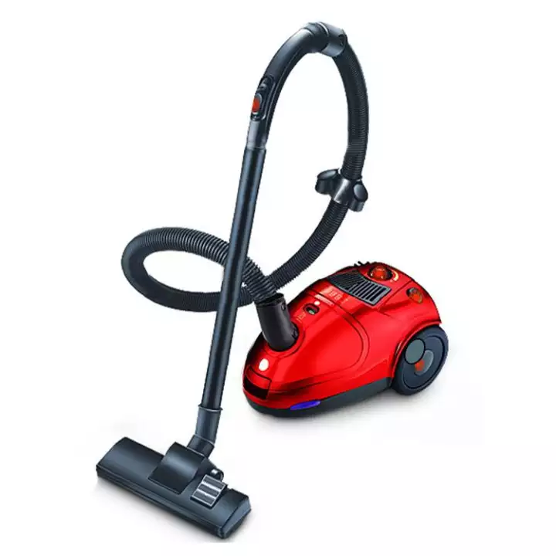
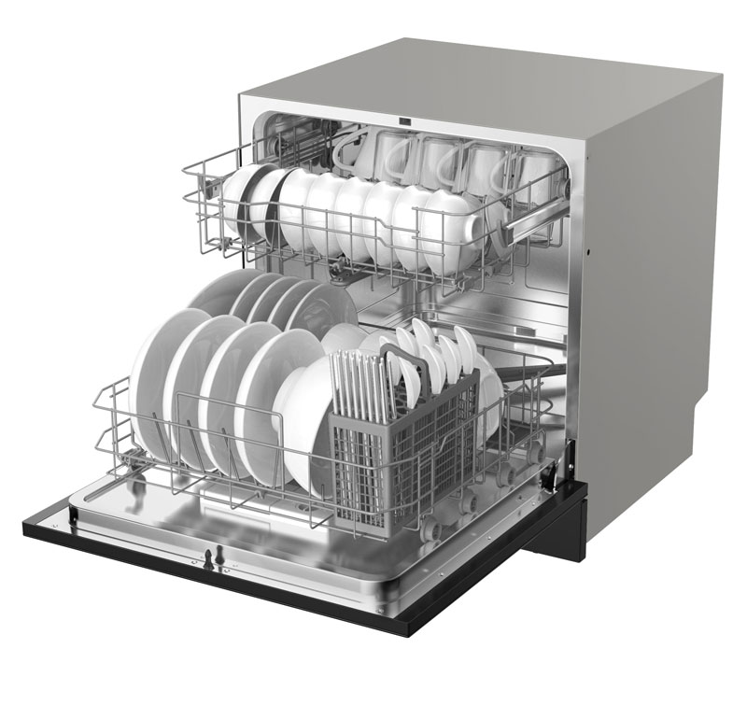
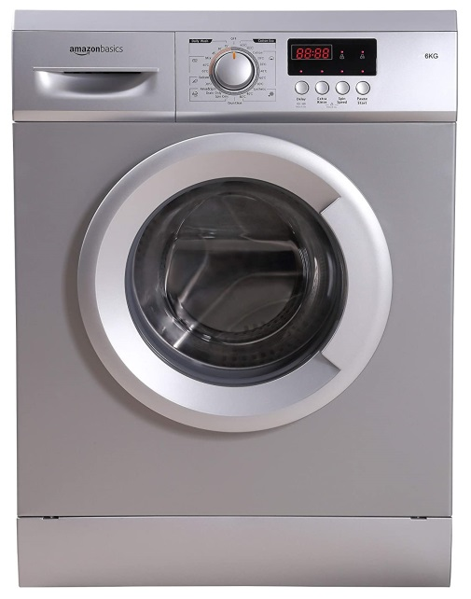
QUESTION 3:
Labour-saving devices

Slide 8
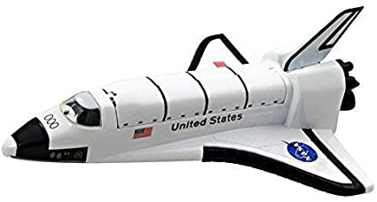
QUESTION 4: What is it?
Space shuttle

Slide 9
I. Pre-speaking:
Give the correct form of the verb in bracket and change it into the passive voice:
Ex: By the end of this month, I …………………..... (finish) my English course.
will have finished
By the end of this month, my English course
will have been finished.
* Future Perfect
Form:
Active: S + will + have + Ved/3 + O
Passive: S + will+ have been + Ved/3 +
(by + O)

Slide 10
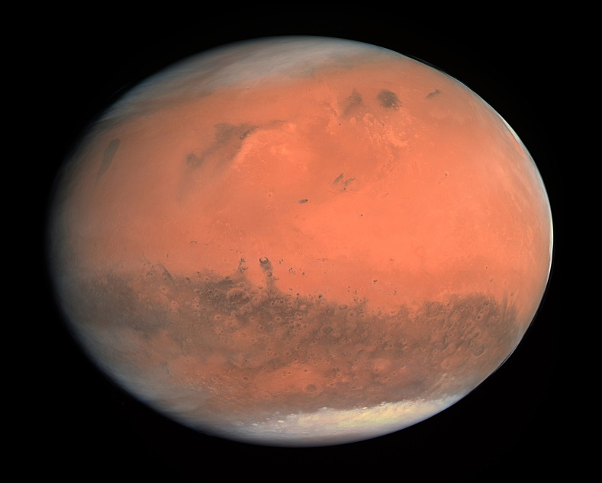
II. While speaking: Task 1 Look at the newspaper cuttings from the future, and say what will have happened by the end of the 21th century.
CHINESE ASTRONAUTS LAND ON MARS
25th October, 2099
By the end of the 21st century,
Chinese astronauts will have landed on Mars.

Slide 11
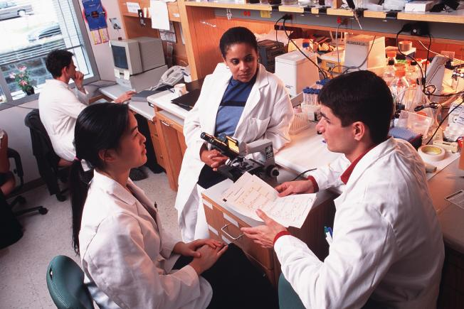
Vocabulary:
Cure/kjʊər/ /kjʊr/ (n,v):
cách điều trị
A: What will have happened by the end of the 21st century?
B: The scientists/ find/ a cure/ the common cold
B: The scientists will have found a cure
for the common cold.

Slide 12
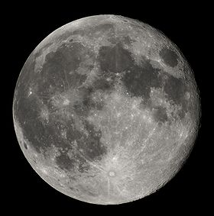
B: The third new moon city / the moon/ be opened.
A: What will have happened by the end of the 21st century?
B: The third new moon city on the moon will have been opened.

Slide 13
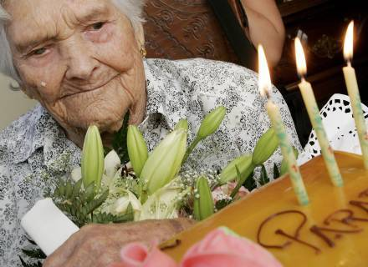
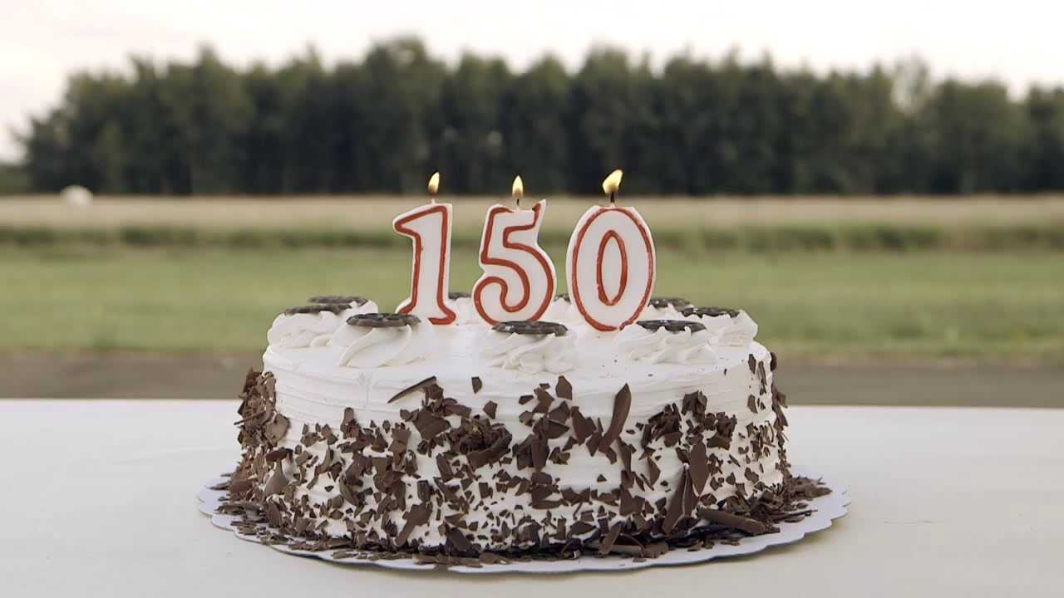
Vocabulary:
Citizen //ˈsɪt.ɪ.zən/
/ˈsɪt̬.ə.zən/ (n)
công dân
A: What will have happened by the end of the 21st century?
B: The world citizens/ celebrate/ 150th birthdays.
B: The world citizens will have celebrated their 150th birthdays.

Slide 14
Task 2: Making predictions about the life in the next 80 years. ( in 2100)
To express a personal idea | To show probability
I my opinion, As far as I know, As far as I’m concerned, To be honest I think, From my point of view, To my knowledge, Personally I think, | It’s (un)likely that + Clause S + be + (un)likely + to V In all likelihood/Probably + Clause It’s (un)doubted that +Clause I doubt that +Clause I’m (not) sure that +Clause S + might/ could…+ Vbare Perhaps/ Possibly, + Clause

Slide 15
Example:
A: What will our life be 80 years from now?
B: It’s likely that cars will have been running on sea water.
A: Why?
B: Because of the development in science and technology.

Slide 16
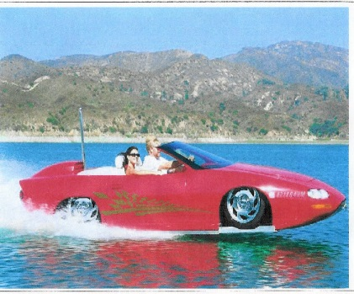
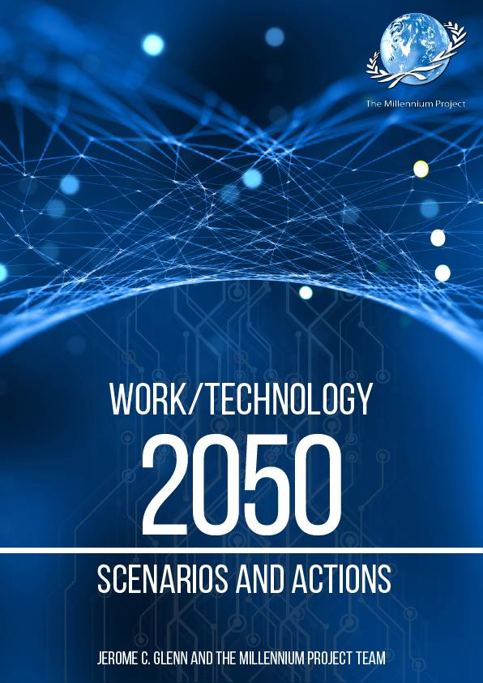
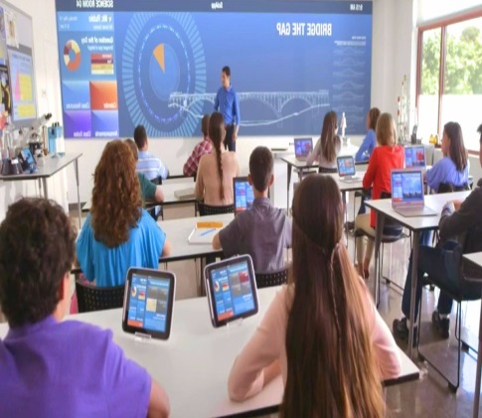
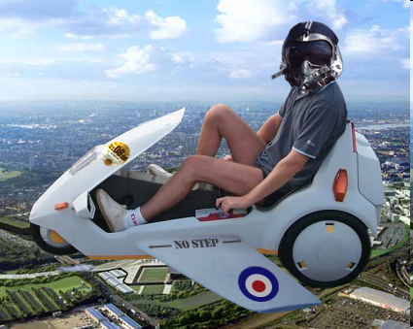
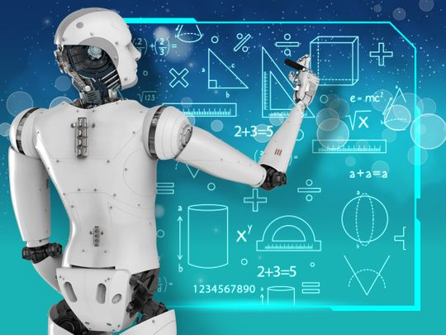
Task 2: making predictions about the life in 80 years
(work in 4 big groups)
G1: Medical field | G2: Transport | G3: At Work – In life | G4: Education

Slide 17
III. POST SPEAKING

Slide 18
IV. HOMEWORK
Learn by heart structures, vocabulary in Speaking part.
Prepare for part C. Listening

